Slide 1
2018-2019 School Year Update

Slide 2
What are the NYS Next Generation ELA & Math Standards?
The goals of the NYS Next Generation ELA and Math Standards are to:
Delineate the knowledge, skills and understanding that students can demonstrate over time when exposed to high-quality instruction and learning experiences.
Clarify what students should know and be able to do independently by the end of each grade (or grade band).
Collectively be focused and cohesive; designed to support a successful transition to various post-secondary paths.
2018-2019 School Year Update

Slide 3
How were the standards created?
The NYS Next Generation Learning Standards for ELA and Mathematics are the result of a two-year collaborative revision process that took place across New York State.
More than 130 teachers (including special education and bilingual education), administrators, parents, higher education reps and stakeholders reviewed each NYS P-12 CCLS (2011) and made suggested modifications.
Reviewers’ suggested modifications were based on:
Their own expertise and experiences.
Public comments.
Additional reviews from the field, as well as researchers and content specialists across grade levels and settings.
2018-2019 School Year Update

Slide 4
ELA – Major organizational changes & vocabulary
Organization: The NYS Next Generation English Language Arts Learning Standards (2017) include the same general organizational structure as the NYS P-12 Common Core Learning Standards for ELA (2011), with some changes. The 2011 and 2017 ELA Standards are both organized under the following major strands: Reading, Writing, Speaking & Listening and Language. Each of these sections has related anchor standards.
Major Changes:
Addition of Lifelong Practices of Readers and Writers
Introduction to Early Learning
Merging of the Reading for Information and Reading for Literature Standards
Revision of the Grade-Level Reading Expectations for Text Complexity
Revision of the Writing Standards
Reduction of the Anchor Standards
Separation of 6-12 Reading Standards for Literacy
Distinct standards for History/Social Studies and Science and Technical Subjects
2018-2019 School Year Update

Slide 5
ELA – Major organizational changes & vocabulary
Key Vocabulary
Learning Standards
Anchor Standards
Grade-level and Grade-band Standards
Lifelong Practices of Readers and Writers
Strands
Range of Student Reading Experiences and Text Complexity
2018-2019 School Year Update

Slide 6
Math – Major modifications and changes
The New York State Next Generation Mathematics Learning Standards (2017) reflect revisions, additions, vertical movement and clarifications to the NYS P-12 Common Core Learning Standards for Mathematics (2011).
Significant changes/modifications include the following:
High school standards listed by course (Algebra I, Geometry and Algebra II).
Standards moved to different grade levels to improve focus; providing more time for students to develop deep levels of understanding of major grade-level content and skills.
New standards were added to strengthen coherence.
Consolidation/removal of standards to improve coherence, focus and reduce redundancy amongst the grade levels.
2018-2019 School Year Update

Slide 7
Math – Major modifications and changes
Significant changes/modifications include the following (continued):
Clarification of existing standards to more clearly identify the expectation of the standard; helping to improve the focus of instruction. Additional notes and illustrations were added to help further clarify standard expectations.
The term “explore” is now used in some standards so students can be introduced to a concept without the expectation of mastery or being assessed.
Maintenance of the rigor of standards by balancing the need for conceptual understanding, procedural skill and application.
Added the supplement “Glossary of Verbs Associated with the Next Generation Math Learning Standards” that contains an explanation of the context in which certain verbs are utilized in the standards.
2018-2019 School Year Update

Slide 8
How are the new standards DIFFERENT than the prior standards?
The new standards clarify vague and/or confusing wording in both ELA and math standards.
Adjustments have been made to ensure new standards are appropriate for the youngest students, multilingual learners and students with disabilities.
The Introduction to the NYS Next Generation Early Learning Standards provides in-depth guidance for pre-K through 2nd grade implementation of standards.
2018-2019 School Year Update

Slide 9
What is the timeline for implementation?
Phase I: Raise Awareness
Winter 2018-Winter/Spring 2019
Phase II: Build Capacity
Spring 2019-Summer 2020
Phase III: Full Implementation
September 2020-ongoing
New NYS 3-8 Grade Assessments
Spring 2021: NYS 3-8 grade assessments will measure the NYS Next Generation Learning Standards.
Information regarding full-implementation/state assessment alignment at the high school level will be forthcoming; however, will not take place prior to the school year 2020-2021.
2018-2019 School Year Update

Slide 10
What should we be doing over the 2018-19 school year?
Raise Awareness
Clearly communicate the adoption and implementation timeline of the Next Generation Learning Standards.
NYS Next Generation Learning Standards At-a-Glance (click to open link)
Next Generation Learning Standards Roadmap (click to open link)
Understand the changes between the standards
ELA Crosswalk (click to open link)
Math Crosswalks (click to open link)
2018-2019 School Year Update

Slide 11
What should we be doing over the 2018-19 school year?
Raise Awareness
Develop a P-12 district/building/grade level curriculum and professional development plan to be utilized during Phase II.
Support the development of summative assessments at the state level.
NYSED Teacher Participation Opportunities (click link to open)
2018-2019 School Year Update
Notes:
Good

Slide 12
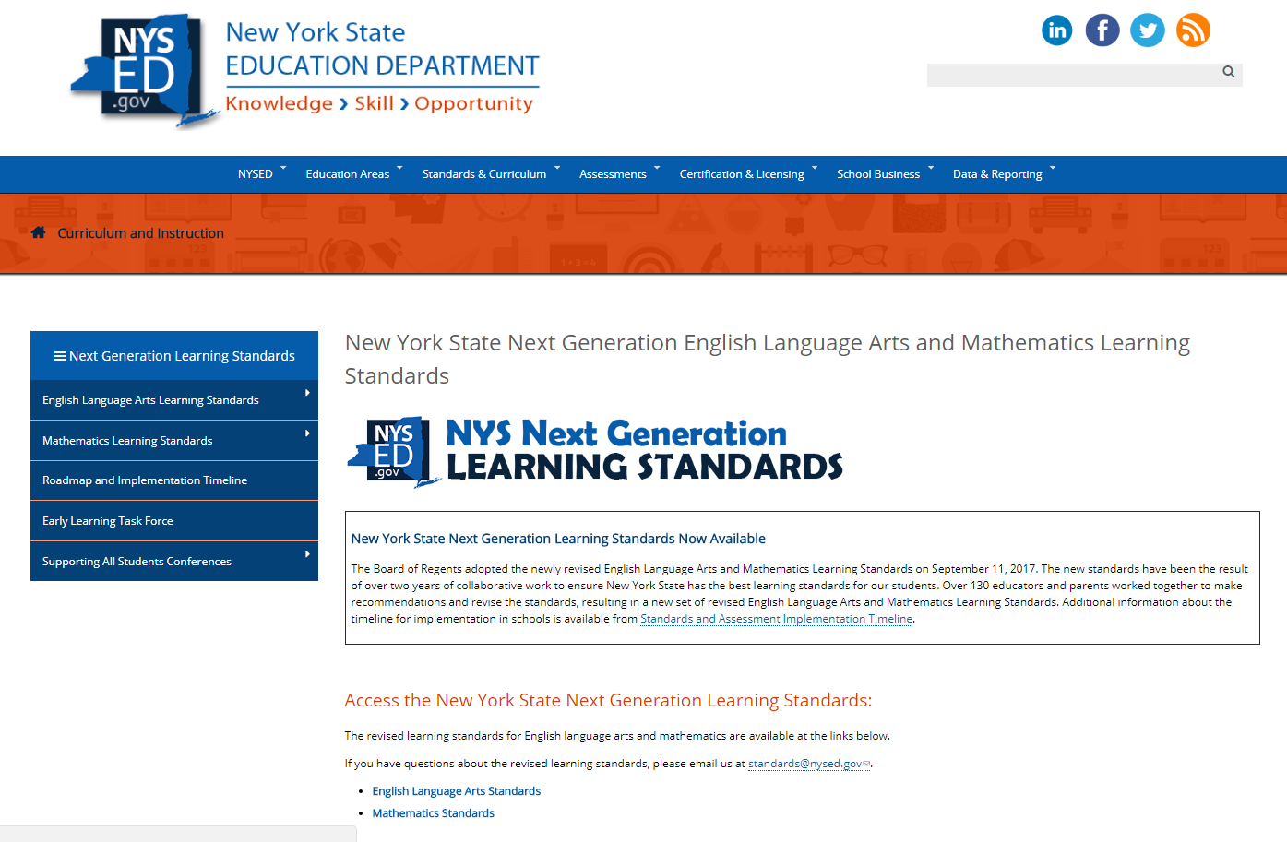
Where can we go for additional learning & resources?
http://www.nysed.gov/next-generation-learning-standards
2018-2019 School Year Update

Slide 13
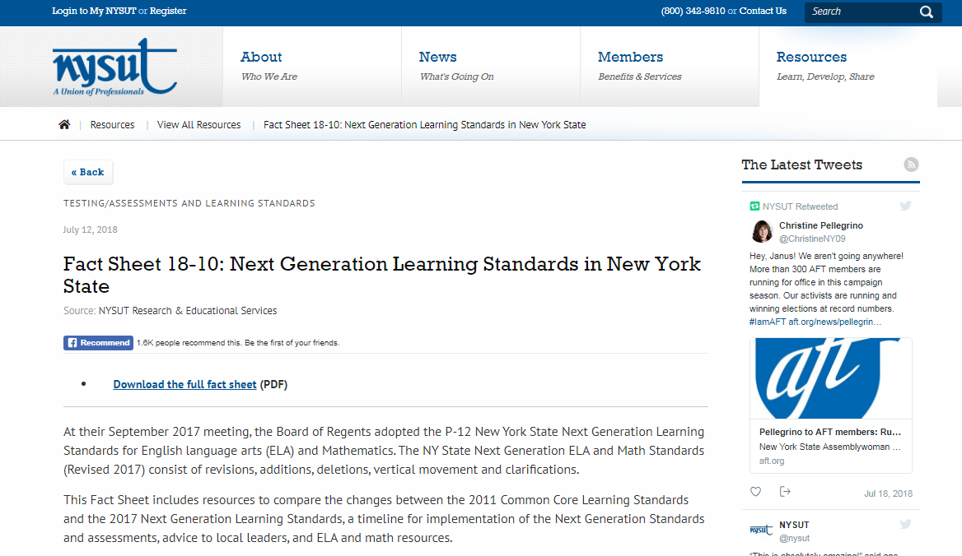
Another good resource:
https://www.nysut.org/resources/all-listing/research/fact-sheets/fact-sheet-next-gen-learning-standards-nys
2018-2019 School Year Update

Slide 14
Additional resources:
Advanced Literacy Briefs
http://www.nysed.gov/curriculum-instruction/new-york-city-regional-supporting-all-students-conference-hunter-college-june-2018
Blueprint for Improved Results for Students with Disabilities
http://www.p12.nysed.gov/specialed/publications/2015-memos/documents/blueprint-students-disabilities-special-education.pdf
Blueprint for English Language Learner Success
http://www.nysed.gov/common/nysed/files/blueprint-for-ell-success.pdf
Supporting All Students Conference Materials
http://www.nysed.gov/curriculum-instruction/new-york-state-next-generation-learning-standards-supporting-all-students
2018-2019 School Year Update

Slide 15
Have a great school year!
Professional Learning Team Organizations:
BOCES
Commission on Independent Colleges and Universities
CUNY
NYC DOE
NYSED
New York State United Teachers
Principals
Professional Standards and Practices Board
SAANYS
SCDN
SUNY
Teachers
Teacher Centers
The Big 5
United Federation of Teachers
2018-2019 School Year Update

