Slide 1


WELCOME to our final Book study – Session 4
An opportunity to experience the story of Brockton High’s transformation, to gain instructional leadership strategies, to discuss the challenges of educational change, and to share your own experiences.

Slide 2
Session 4 Agenda
3:00-3:07
I. Brief Recap to Sessions 1,2, and 3
II. Getting Buy-in/Dealing with Resistance
A. Strategies for getting buy-in
B. But what about those who did NOT buy-in and continued to resist
C. Who resisted and how we dealt with their resistance
D. Questions
III. More Examples of Literacy Workshops A. Literacy Workshop (calendar): Reading and Analyzing Visuals
3:07-3:20
3:20-3:55

Slide 3
Session 4 Agenda (cont)
B. Literacy Workshops (teacher toolbox): Asking Rigorous Questions and Effective Entry Routines
C. Your Turn: QUESTIONS???
IV. Advice For Your Journey
OPTIONAL: Time for anyone who wants to stay on for additional questions/discussion
3:55-4:00
4:00-4:30

Slide 4
Recap to Sessions 1,2,3

Slide 5
What happened? The turnaround:
We went from this:
To this:
75% failing MCAS
Nearly all passing
Culture of low expectations/ students have a right to fail
High standards/High Expectations/NO Excuses
Not our fault, what are we supposed to do?
We are ALL responsible for success of EVERY student
Success by chance. Are you lucky enough to get the teacher who teaches writing?
Success by design. School wide initiative. Literacy for ALL, every class!
Negative image in our city/ failing school/ cesspool
National Model School, awards, “jewel of the city”

Slide 6
What happened? The turnaround:
We went from this:
To this:

Slide 7
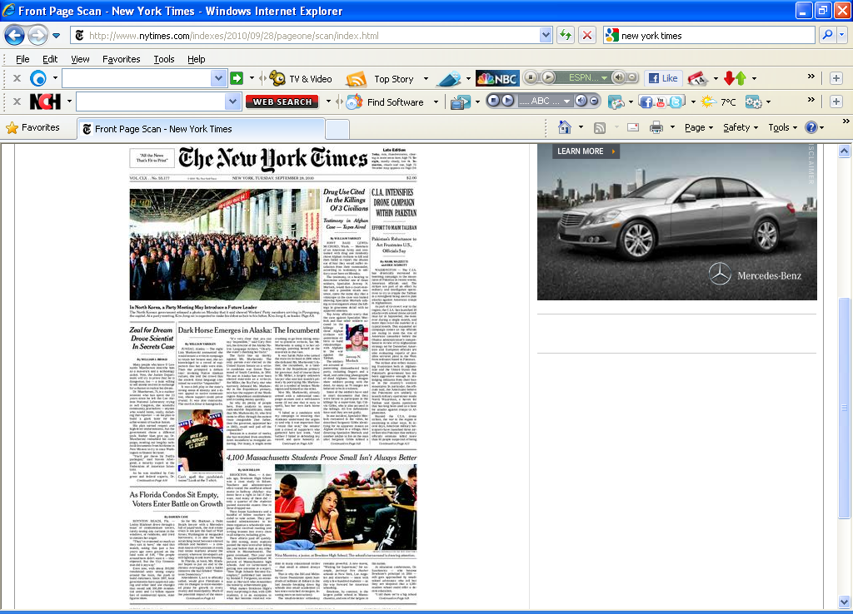

To THIS!!!
Boxers in the NEW YORK TIMES
High Expectations
NO Excuses!!!
September 28, 2010

Slide 8
And after over a decade!

Slide 9

NO secret sauce
NO silver bullets
NO magic formula
NO special programs
If we can do this, ANYONE can!

Slide 10
Our FOUR transformation steps:
Empower a team
Focus on LITERACY for ALL
Implement with a plan, and with fidelity
Monitor like crazy

Slide 11
The Key to Success:
Adult Learning

Slide 12
Defining the Focus:
We defined LITERACY
Here is what LITERACY means at Brockton High

Slide 13
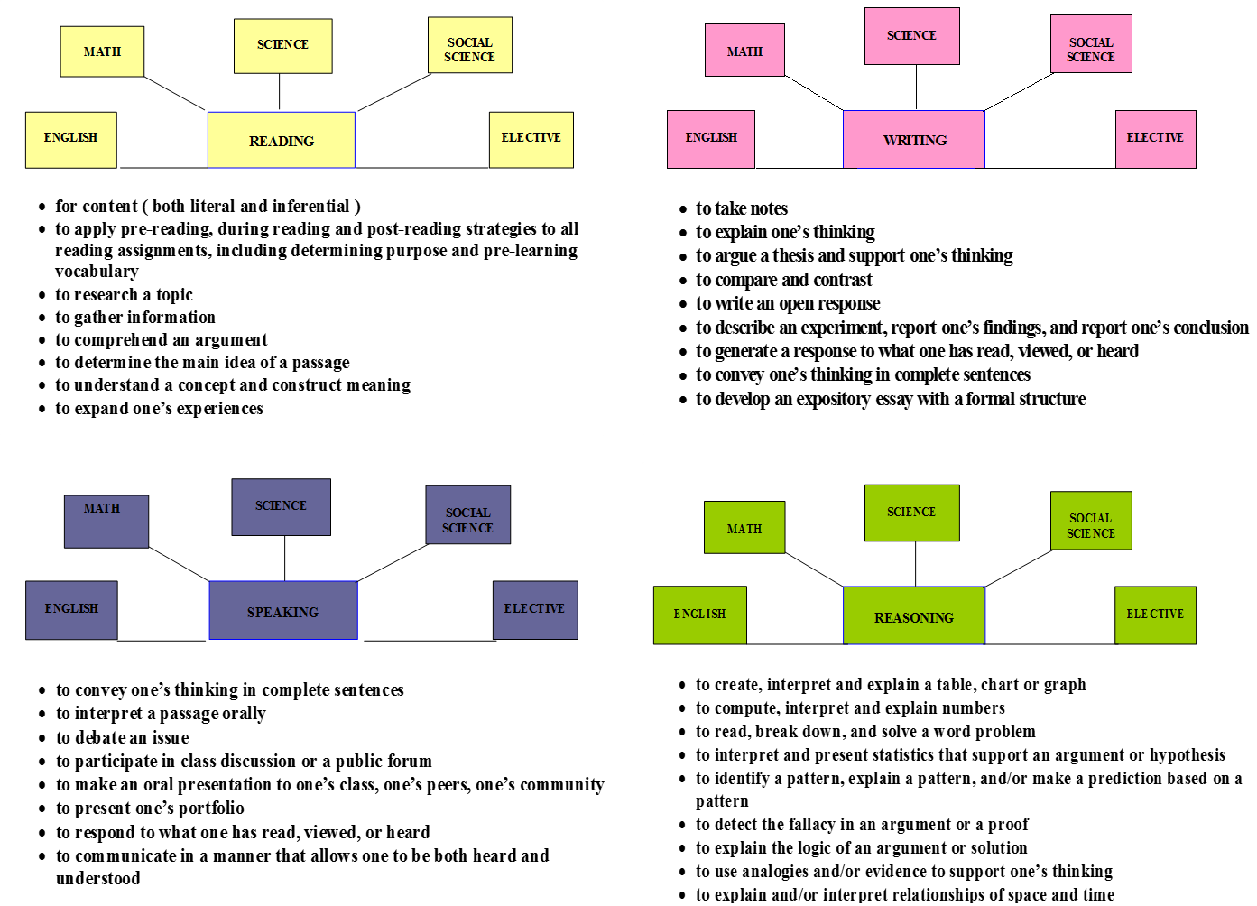
Brockton High Literacy Initiative

Slide 14
Literacy for ALL:
Once we clearly defined LITERACY, then what??

Slide 15
Our FOUR transformation steps:
Empower a team
Focus on LITERACY for ALL
Implement with a plan, and with fidelity
Monitor like crazy

Slide 16

It’s about instruction:
We knew that the “HOW WE TEACH IT” matters…
How many of your teachers are like me? Me, teach reading???

Slide 17

Quality of Instruction
“The main lesson was that student achievement rose when leadership teams focused thoughtfully and relentlessly on improving the quality of instruction.”
The Achievement Gap Initiative At Harvard University
Toward Excellence with Equity
Conference Report by Ronald F. Ferguson, Faculty Director
Notes:
17

Slide 18
The key to our transformation:
ADULT LEARNING and SUPPORT
We modeled for the faculty the process that they would then teach to the students.

Slide 19
FOCUS, FOCUS, FOCUS
We started with writing! WHY???
Writing is thinking

Slide 20
Let’s Review Our Process::
Restructuring Committee targets a skill
Committee develops a step-by-step process for teaching that skill to students
ALL teachers are trained in a Literacy Workshop modeling the process
Teachers are given time AND support to develop their contextual lesson to teach the skill
Implementation according to a schedule
Monitoring of the implementation

Slide 21
Last time I shared the Open Response Writing Workshop with you… more workshops coming today

Slide 22
Remember
It’s about the adults, not the kids!
We taught ourselves to teach these literacy skills to the students.
And we will ALL do it THIS WAY!

Slide 23
Literacy Workshop Strategy:
Restructuring Committee determines topic based on data, our needs
Restructuring Committee develops script, we all review and practice
Here’s the general structure of the Literacy Workshop:
  Introduce topic/ Always use an Opener
  WHY are we doing this (provide some data/research)
  Model the steps that teachers will then teach to the students
  Provide guided practice of the skill
  Independent practice of the skill
  Opportunity for questions/Next steps
  Closer

Slide 24
BUT, please don’t think that everyone was HAPPY about this literacy focus…
The resistance was building!!!

Slide 25
Getting Buy-In and Dealing with Resistance (NO, not everyone was happy about this!!!)

Slide 26
As the Open Response Writing implementation continued (remember how we used the calendar), the resistance began to grow!

Slide 27
Success by DESIGN, not by chance!
The Open Response calendar of implementation:
Nov 2-6: Social Science, Social Sci Biling.
Nov 30-Dec 4: Wellness, JROTC
Dec 14-18: Science, Science Bilingual
Jan 11-15: Business, Tech, & Career Ed.
Jan 25-29: Math, Math Bilingual
Feb 22-26: Foreign Lang, Special Ed
Mar. 7-11: English, ESL, Guidance
Mar 20-24: Family &Cons. Sci, ProjGrads
Apr 5-9: Music, Art

Slide 28
Let’s talk about BUY-IN
The question we are asked most often: How did you get the faculty to buy-into the Literacy Initiative?

Slide 29
TWO PART ANSWER:
PART ONE:
We engaged the faculty using:
  Quality PD with our Literacy Workshops
  Structured Discussion Groups
  World Café format for discussion
  Celebrations and thanks
  Their voices were sought, heard
BUT…

Slide 30
TWO PART ANSWER:
PART TWO:
TRUTH – It didn’t always work. There were people who NEVER bought in… NEVER!!!
BUT, if we waited for buy-in, we’d still be waiting.

Slide 31
What Gets Buy-In?
What Gets Buy-In?
RESULTS!

Slide 32
Changes in ELA Results Year One of School Wide Open Response
Grade 10 – English Language Arts
Performance Level | 1998 | 1999 | 2000 | 2001
Advanced | 2 | 2 | 6 | 14
Proficient | 20 | 22 | 21 | 29
Needs Improvement | 34 | 35 | 32 | 34
Failing | 44 | 41 | 41 | 23

Slide 33
Changes in Math Results Year One of School Wide Open Response
Grade 10 – Mathematics
Performance Level | 1998 | 1999 | 2000 | 2001
Advanced | 1 | 2 | 5 | 8
Proficient | 6 | 7 | 11 | 22
Needs Improvement | 17 | 16 | 21 | 36
Failing | 75 | 76 | 64 | 34

Slide 34
Changes in ELA Results Year One of School Wide Open Response
Added a Literacy Workshop on Active Reading Strategies
Grade 10 – English Language Arts
Performance Level | 1998 | 1999 | 2000 | 2001 | 2002
Advanced | 2 | 2 | 6 | 14 | 22
Proficient | 20 | 22 | 21 | 29 | 14
Needs Improvement | 34 | 35 | 32 | 34 | 25
Failing | 44 | 41 | 41 | 23 | 13

Slide 35
What Gets Buy-In?
It’s about the adults!!!
Buy-in often takes time. If we waited for buy-in, we’d still be waiting!!!
Let’s think about our faculty…

Slide 36
Three Segments of Faculty
Your movers and shakers,
sprinters, teacher-leaders
Top Third
Your good, but cautious teachers. They need to see the evidence before they get on board.
Middle Third
Bottom Third
The “over my dead
body” crowd (our ODGs)

Slide 37
Dealing with the Three Segments of the Faculty
Your movers and shakers,
sprinters, teacher-leaders
Top Third
For that Top Third
Middle Third
Recruit, leadership teams, deliver PD, rely on them, reward them
Bottom Third

Slide 38
Dealing with the Three Segments of the Faculty
Your good, but cautious teachers. They need to see the evidence before they get on board.
Top Third
For that Middle Third
Middle Third
Engage them, listen to them, train them, support them, mandate and monitor!
Bottom Third

Slide 39


Dealing with the Resistance
The book burners, the “over my dead body” crowd, the ODGs
Top Third
For that Bottom Third
Middle Third
You have to address it directly and move ahead with the agenda. Check out the book burning and other stories of resistance on pages 55-59.
Bottom Third

Slide 40
Introducing five members of this group:
Ms. This Too Shall Pass
Mr. Independent
Ms. Afraid to Try
Mr. Pretender
Ms. Over My Dead Body
Suggestion: Talk about each of these profiles with your team in case you face this.

Slide 41
Ms. This Too Shall Pass
A good, skillful teacher, but has lived through so many reforms, mistrustful of any change as "yet another thing". Won't be "on board" until she sees the results.
Our most effective strategy:
How do handle this teacher?

Slide 42
Mr. Independent
Strong personality, loved by the kids, but often thinks of himself as the superstar who knows what’s best, after all who does the principal think s/he is anyway telling me what I can teach. Believes he is the best teacher in the school and already knows the best way to teach.
Our most effective strategy:
How do handle this teacher?

Slide 43
Ms. Afraid to Try
A not so skillful teacher who struggles with employing a variety of strategies, runs a teacher-centered classroom, and is afraid to try anything different for fear of failing in front of the class.
Our most effective strategy:
How do handle this teacher?

Slide 44
Mr. Pretender
Always says YES to everything, wants to SEEM like she’s on board. Talks about his classroom like it’s all being done. But when it comes time for the results, they aren’t there and all you get are excuses about what the kids can’t do or didn’t do. He has a mindset of low expectations for the students.
Our most effective strategy:
How do handle this teacher?

Slide 45
Ms. Over My Dead Body
You wonder why this person even became a teacher. She is loud, an obstructionist, not a team player at all, does things HER way, thinks of her classroom as her kingdom, and will likely be defiant, even insubordinate.
Our most effective strategy:
How do handle this teacher?

Slide 46
Taking on the Resistance -Directly
Principle #8
You will always face resisters and naysayers. They key is how you deal with them.
And it can be awful!

Slide 47
Faculty
Here’s a suggestion to neutralize the negativity:
Put all your negative folks together in a group so they don’t spread their toxic fumes.
!
BUT DON’T TELL THEM!!!

Slide 48
What Gets Buy-In?
What do you do when everything you have tried to do to support the teacher hasn’t worked? Actually, they don’t want it to work… they didn’t even try.

Slide 49

What Gets Buy-In?
“Fierce conversations are about moral courage, clear requests, and taking action.
Fierce is an attitude.”
-Susan Scott from
Fierce Conversations

Slide 50
Regarding Resistance:
Engaging faculty helps with buy-in, BUT
You can’t wait for everyone to buy-in; you must move ahead with your agenda
There WILL be resistance, BUT
Not all resisters are negative
You must confront the resistance directly and MOST IMPORTANTLY
Your leadership matters – A LOT!!!

Slide 51
Examples of Actual Literacy Workshops

Slide 52
Two types of Literacy Workshops:
School wide calendar implementation
Teacher “Toolbox Strategies”
I’ll share an example of each

Slide 53
Two types of Literacy Workshops
School wide calendar implementation: Everyone implements as assigned. Benefits:
Highlights the school’s focus
Provides consistent process of instruction
Ensures students receive repeated, deliberate practice of the target skill.

Slide 54
Two types of Literacy Workshops
School wide calendar implementation: Some examples:
Active Reading/Open Response Writing
Reading for Purpose
Graphing Across the Curriculum
Reading and Analyzing Visuals
Problem Solving

Slide 55
BHS Literacy Workshop
April 28th 2011
Reading Visuals

Slide 56
Agenda
Opener – Think and Pair.
Reading Visuals presentation
Practice using Reading Visuals 5 step process
Discussion and feedback
Closer – Think, Plan, Share
Notes:
Ask opening question (relevant)

Slide 57
OPENER:
Let’s take three minutes for this two question Quick Write:
What was something that you recently learned through a visual of some kind?
What visual representations of data or information do you find you use most often in your classroom?
Notes:
Ask opening question (relevant)

Slide 58
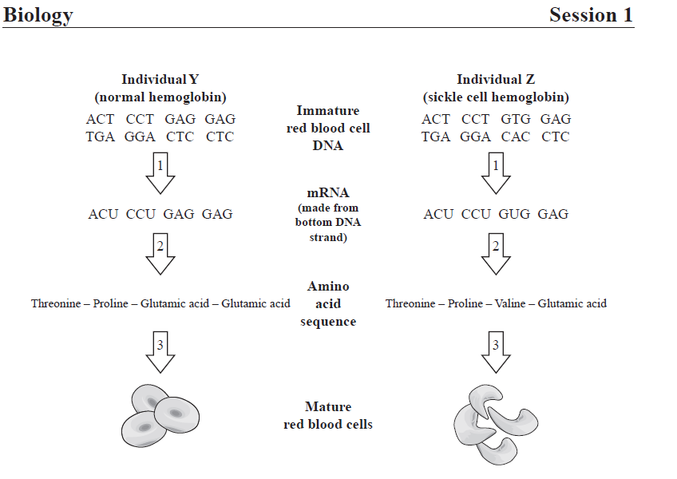
What We Know
There are several types of visuals used in all classes and on both the science and math MCAS exams.
Students often attempt to answer the questions without fully understanding the content of the visual.

Slide 59
Reading Visuals
The process of reading a visual begins with understanding and analyzing the given information BEFORE attempting to answer the questions or solve a problem.

Slide 60

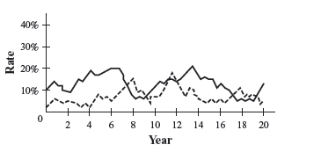

Reading Visuals
Introductory Information
Title
Key or Legend
Labels and parenthetical information
Correlations
Notes:
Teachers practice the skill
Wait time 3 min

Slide 61
5 Steps for Reading Visuals
Identify the type of visual
Determine the topic of the visual
Examine the given information from the visual (including all introductory text)
Develop predictions, deductions, inferences or conclusions about the visual
Analyze the questions and determine the information needed from the visual

Slide 62
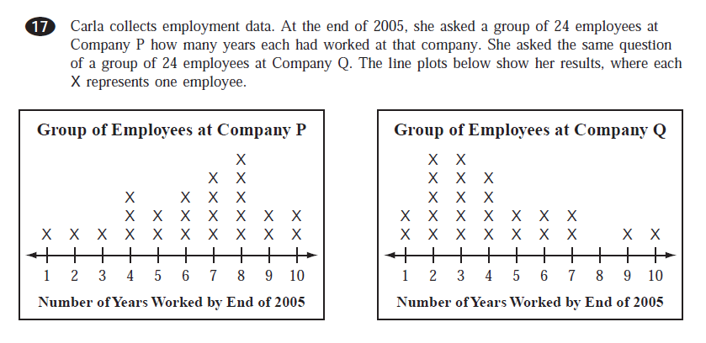
5 Steps for Reading Visuals
Practice Steps 1-4 using the math data below.

Slide 63
Your Turn
5 Steps for Reading Visuals
Identify the type of visual
Determine the topic of the visual
Examine the given information from the visual (including all introductory text)
Develop predictions, deductions, inferences or conclusions about the visual
Analyze the questions and determine the information needed from the visual

Slide 64
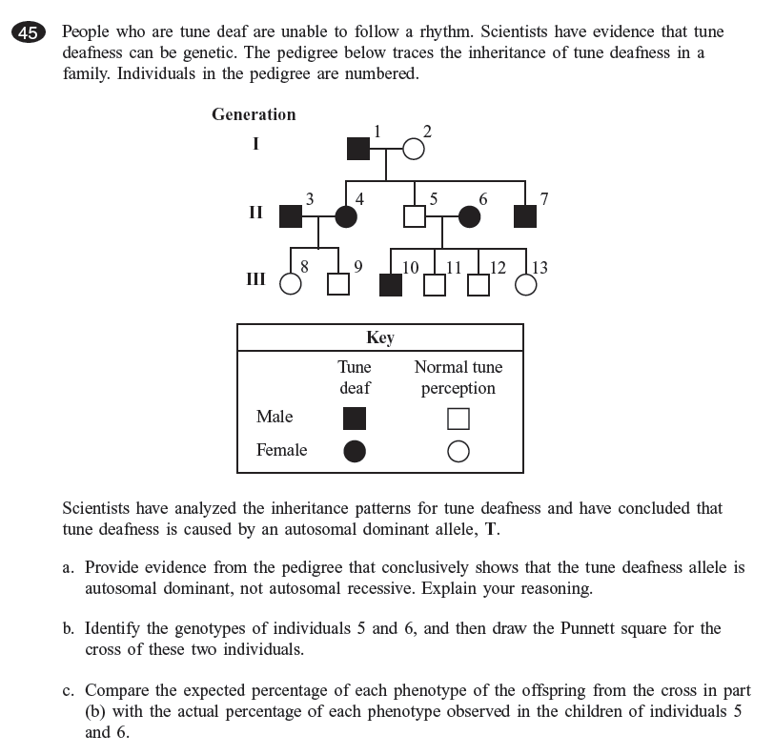
Notes:
Cut the questions and have them appear separately

Slide 65
Looking Ahead
The May 5th faculty meeting will be in department and will focus on using the Reading Visuals Steps with content specific graphs, tables and diagrams
Over the next few weeks we will all use visuals in classes to help students develop stronger reading and reasoning skills
Our goal is to improve student achievement across the board and see gains in the science and math MCAS exam scores

Slide 66
Closer
Think – Plan – Share
Identify a visual or type of visual you will use to teach students the Reading Visuals Steps.
Describe how the steps for reading visuals will help your students improve their reading and reasoning skills.

Slide 67
We have the power to improve student achievement!
Thank you

Slide 68
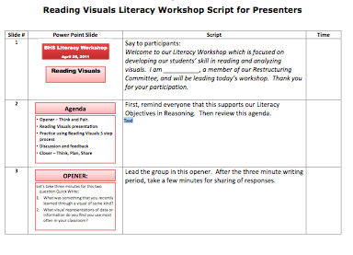
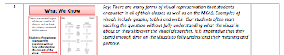

Slide 69
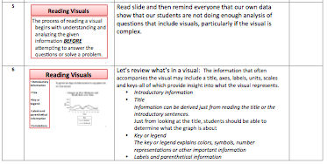
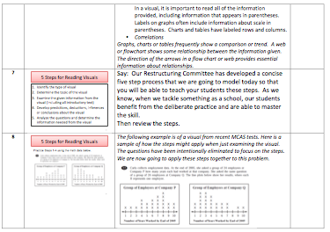

Slide 70
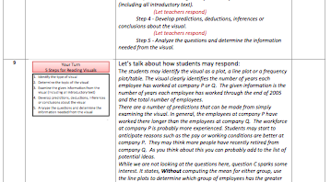


Slide 71
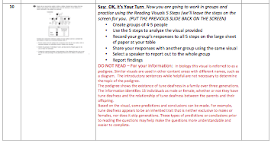

Slide 72
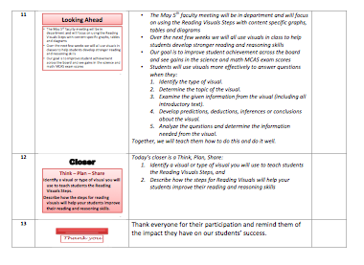

Slide 73
How did we incorporate these Literacy Skills in every discipline?
The Reasoning Skills Chart develops the higher level math skills.
Here is an example of a
Reading Visuals lesson
from a Wellness class
Topic: Bullying

Slide 74
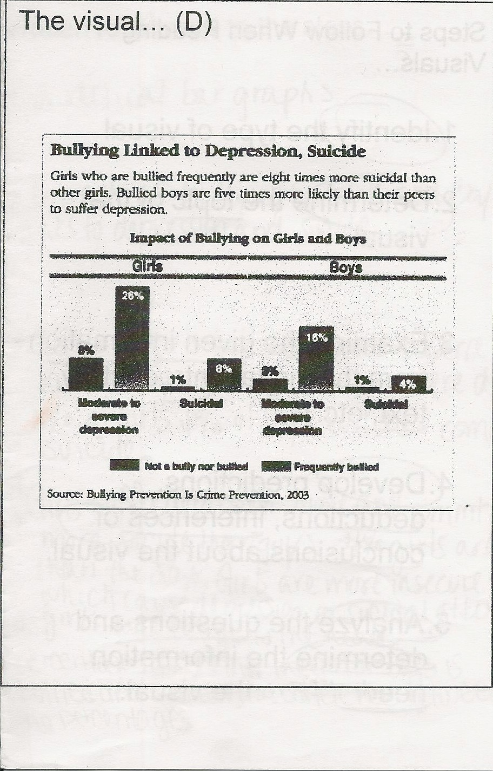
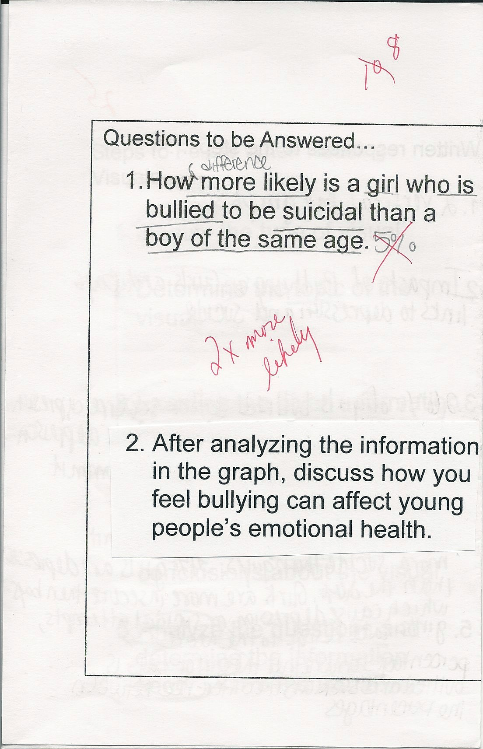

Slide 75
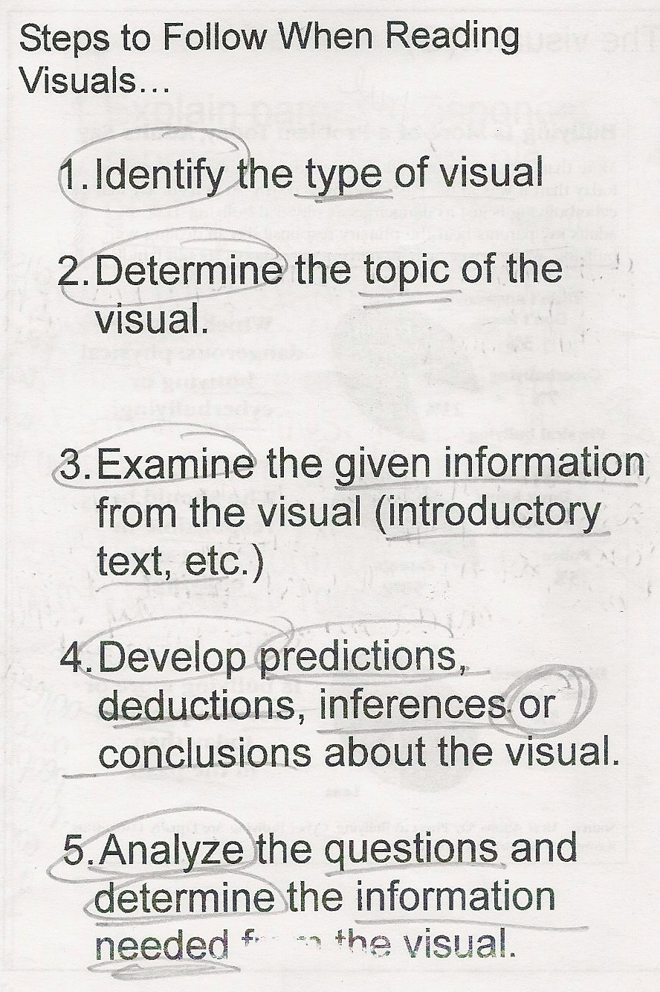
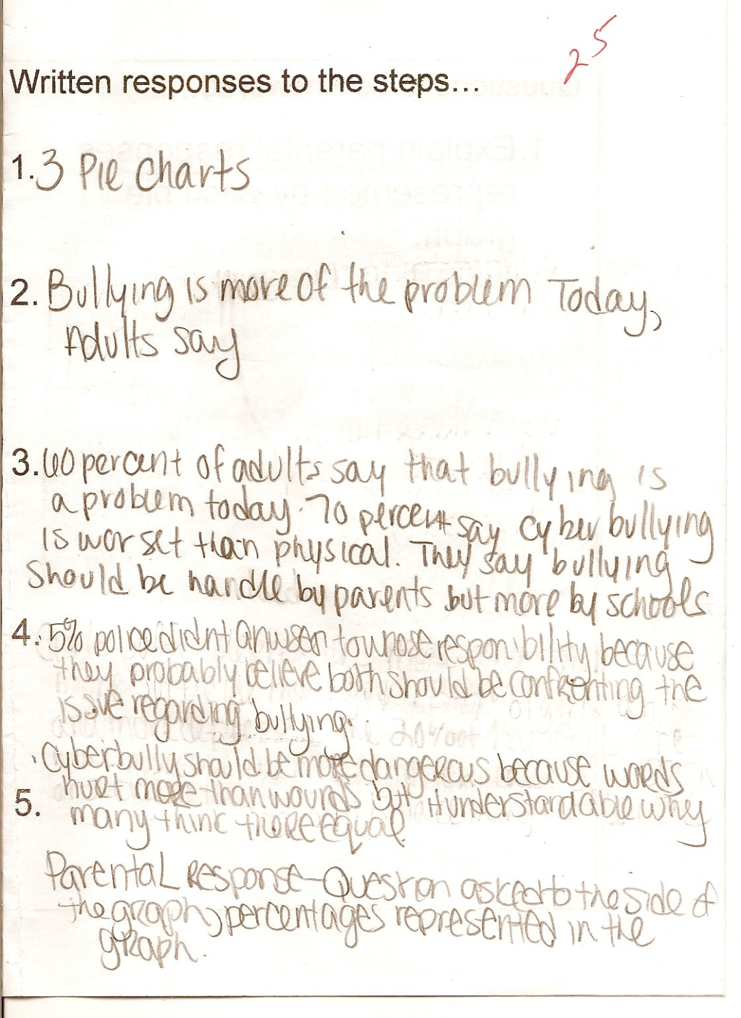

Slide 76
Two types of Literacy Workshops
Teacher Toolbox Strategies: Calendar NOT required. Should be used consistently in class by all teachers. Benefits:
Research based strategies taught to all teachers – “How to”
Improves instruction across the school
Colleague-to-colleague sharing of best practices

Slide 77
Two types of Literacy Workshops
Teacher Toolbox Strategies:
Some examples:
Asking Rigorous Questions
Effective Openers and Closers
Vocabulary in Context
The Power of Quick Writes and Graphic Organizers
Developing Speaking Skills
No Opt Out and Everybody Writes
Providing Effective Feedback

Slide 78
Another example of a teacher developed and led workshop (a Teacher Toolbox Strategy):
Asking Rigorous Questions

Slide 79
Asking Rigorous Questions
Welcome to our Literacy Workshop

Slide 80
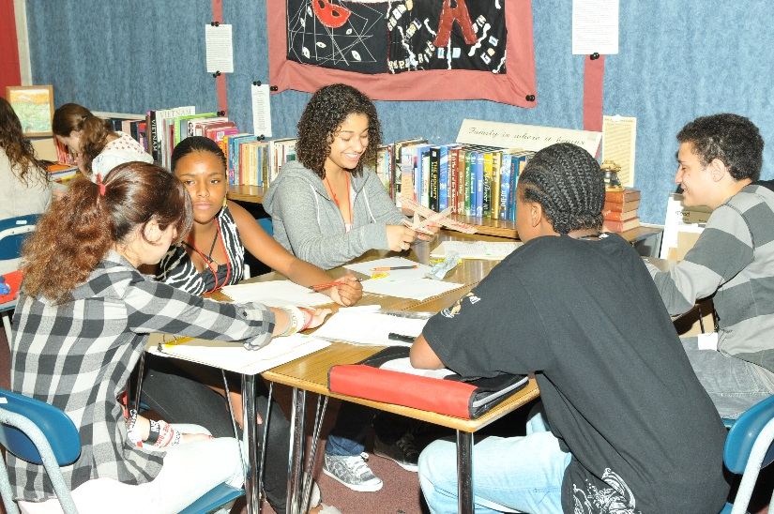
OUR AGENDA
Opener
Purpose of the workshop
Characteristics of questions
Reviewing the Rigor/Relevance Framework
Connections to questioning
Next steps
Closer
Questions???

Slide 81
Opener
Despite our best efforts and careful planning, things do not always go as planned. Watch this clip of a history class in action. Have you ever felt like this???

Slide 82
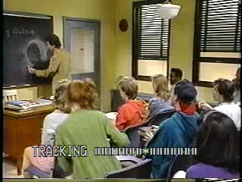
Go to YouTube and search Seinfeld teaching History on SNL

Slide 83
Let’s share a bit…
If you were observing Mr. Seinfeld’s class, what are some recommendations you would give him about his questioning technique?

Slide 84
Why do we need to focus on questioning
After our continuing work on writing across the curriculum and our frequent review and comparison of student work:
“I have noticed that the quality of my students’ writing can depend upon the quality of the question I asked.” BHS teacher

Slide 85
Let’s Brainstorm:
Think about the best questions you’ve asked your students. Take a few minutes to list the characteristics of effective and rigorous questions.
Let’s share…

Slide 86
What the research says:
Characteristics of Effective Questions:
Stated clearly
Engaging
Uses vocabulary that students understand
Builds upon knowledge students possess
Clear purpose related to the lesson/unit objectives
Content focus
Contain cue words to guide students toward the type of response desired‐explain, support, prioritize, interpret

Slide 87
Characteristics of Ineffective Questions:
Require merely yes or no responses
Are designed to trick the student
Encourage random guessing rather than critical thinking
Coerce or grill the student to come up with a particular response
Are so general or vague that the students are unclear about how to develop a response.

Slide 88
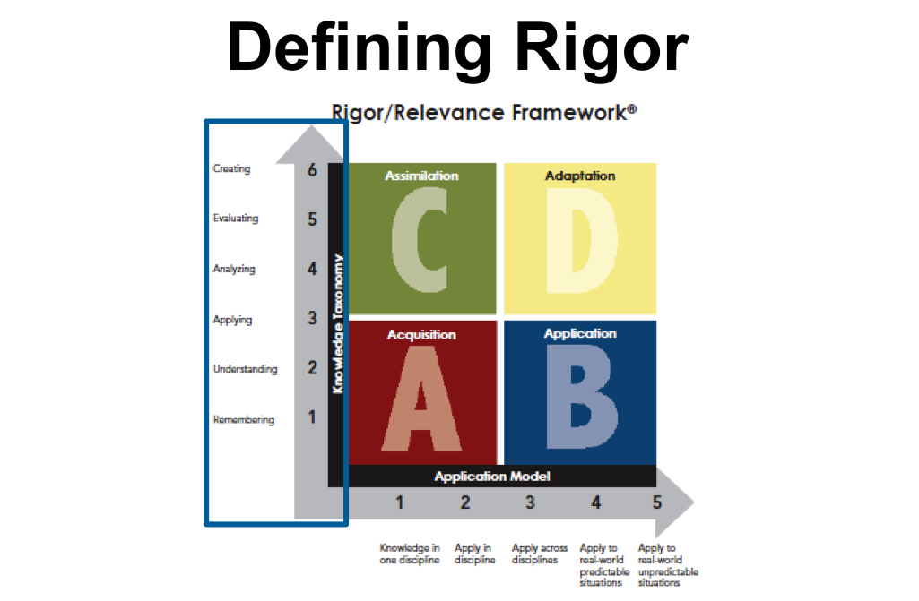
Remember the Rigor/Relevance Framework

Slide 89
Rigor is…
Rigor is not…
Scaffolding thinking
Planning for thinking
Assessing thinking about content
Recognizing the level of thinking students demonstrate
Managing the teaching/learning level for the desired thinking level
More or harder worksheets
AP or honors courses
The higher level book in reading
More work
More homework

Slide 90
Misconceptions about rigor
MORE – does not mean more rigorous.
DIFFICULT – increased difficulty does not mean increased challenge.
RIGID – “all assignments are due by… no exception.”
AGE MATTERS – young children naturally take what they are learning to solve unpredictable problems – make it developmentally appropriate.

Slide 91
Misconceptions about rigor
MUST MASTER BASICS FIRST – Any level of learning can be rigorous. It’s all about the design of the learning experience.
FOR THE ELITE – To reserve rigorous learning opportunities for the “elite” students while relegating others to lives of memorization and participation in meaningless activities does not meet the demands of 21st century learners. ALL can and should have equal access to rigorous instruction and learning.

Slide 92
How can we increase rigor in our questions:
“It is not the answer that enlightens, but the question.”
~ Decouvertes ~

Slide 93
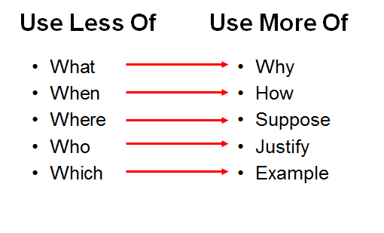
To move to higher-order questions

Slide 94
First Step to Rigor and Relevance: Change the Questions
Low Rigor Questions
High Rigor Questions
*If photosynthesis did not exist, how would your morning have been different today?
*What is photosynthesis?
*What is the correct answer for problem four?
*How many different ways can you think of to solve problem four?
*What decisions did President Thomas Jefferson make that have an impact on current economics?
*When did Thomas Jefferson serve as president?

Slide 95
How can we increase rigor in our questions:
Let’s share some of your questions…

Slide 96
Open-Ended Rigorous
Question Examples
Why?
Defend your answer.
What is another way to explain this?
Do you agree or disagree? Why?
How do you know?
What is another example?
Please tell us one use for…
How might you represent this information in another way?
What other text does this remind you of?
If you could ask a question, what would it be?
What’s still confusing you?
What do you now understand so well that you could teach it to someone else?
Is there an alternate solution?

Slide 97
To help you: Verb List by Quadrant

Slide 98
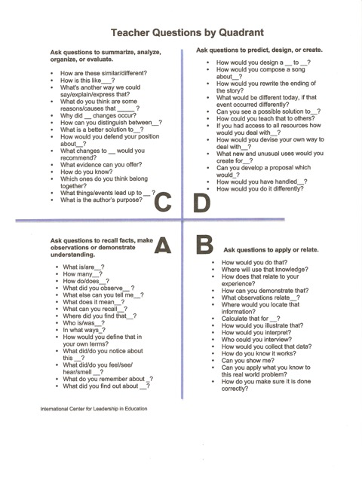
To help you as you create rigorous questions:

Slide 99
Let’s pull this all together:
These next five slides provide some questions based on Blooms Taxonomy that prompt students’ thinking and increase the rigor in your questions that you may use in your various writing assignments, in Openers and Closers and Quick Writes.

Slide 100
Check for Understanding: Describe and Explain
Do you know anything about…? And how does it compare to…?
Describe…using your sensory words and your new content words.
Explain what is meant by…How does that compare to what you or others believe/see/explain?
What is an example of…?

Slide 101
Check for Understanding: Analysis and Summarization
What is the pattern?
Why?
Compare and Contrast…
How is this the same or different?
What is the cause or effect?
Sort these into categories and label the categories.
What attributes impact these functions?
What is the most important idea and why?
Summarize…
From what point of view will you summarize…

Slide 102
Check for Understanding: Evaluation and Creativity
Give me another example of…, but this time…
Defend your answer
Justify your conclusion
What are the pros and cons?
What if…?
What is the relationship of…to…?
Is this fair or right?
Is this right or wrong and why?
What is the importance, impact, or value of…?

Slide 103
Check for Understanding: Evaluation and Creativity
Can you design a...to...?
Why not compose a song or write an original piece about...?
Can you see a possible solution to...?
If you had access to all resources how would you deal with...?
Why don't you devise your own way to deal with...?
What would happen if...?
How many ways can you...?

Slide 104
A few more prompts for creative thinking and powerful learning:
Can you create new and unusual uses for...?
Can you write a new…for…?
Can you develop a proposal which would...?
What if…?
Add a real or imagined scenario
Change a variable
Design…
Solve this issue or situation…

Slide 105
Expectations and Student Success
REMEMBER: Students can do no better than
  the assignment they are given…
  the assessment they are given…
  the tools and strategies they are taught to use…
  the questions they are asked and the questions they themselves ask…
  the feedback they are given…
  what they spend time doing and the models they receive
  From: Educational Trust

Slide 106
CLOSER: Think-Pair-Share
THINK: Review the questions you brought that you will be using soon in your class and think about where they fall in the R&R Framework.
PAIR: Partner up with a colleague and together upgrade and rewrite those questions where you feel you could increase the rigor of your students thinking and writing.
SHARE: Let’s share some of the best of your examples.

Slide 107
THANK YOU, THANK YOU, THANK YOU!!!
We make a difference for our students!

Slide 108


Slide 109
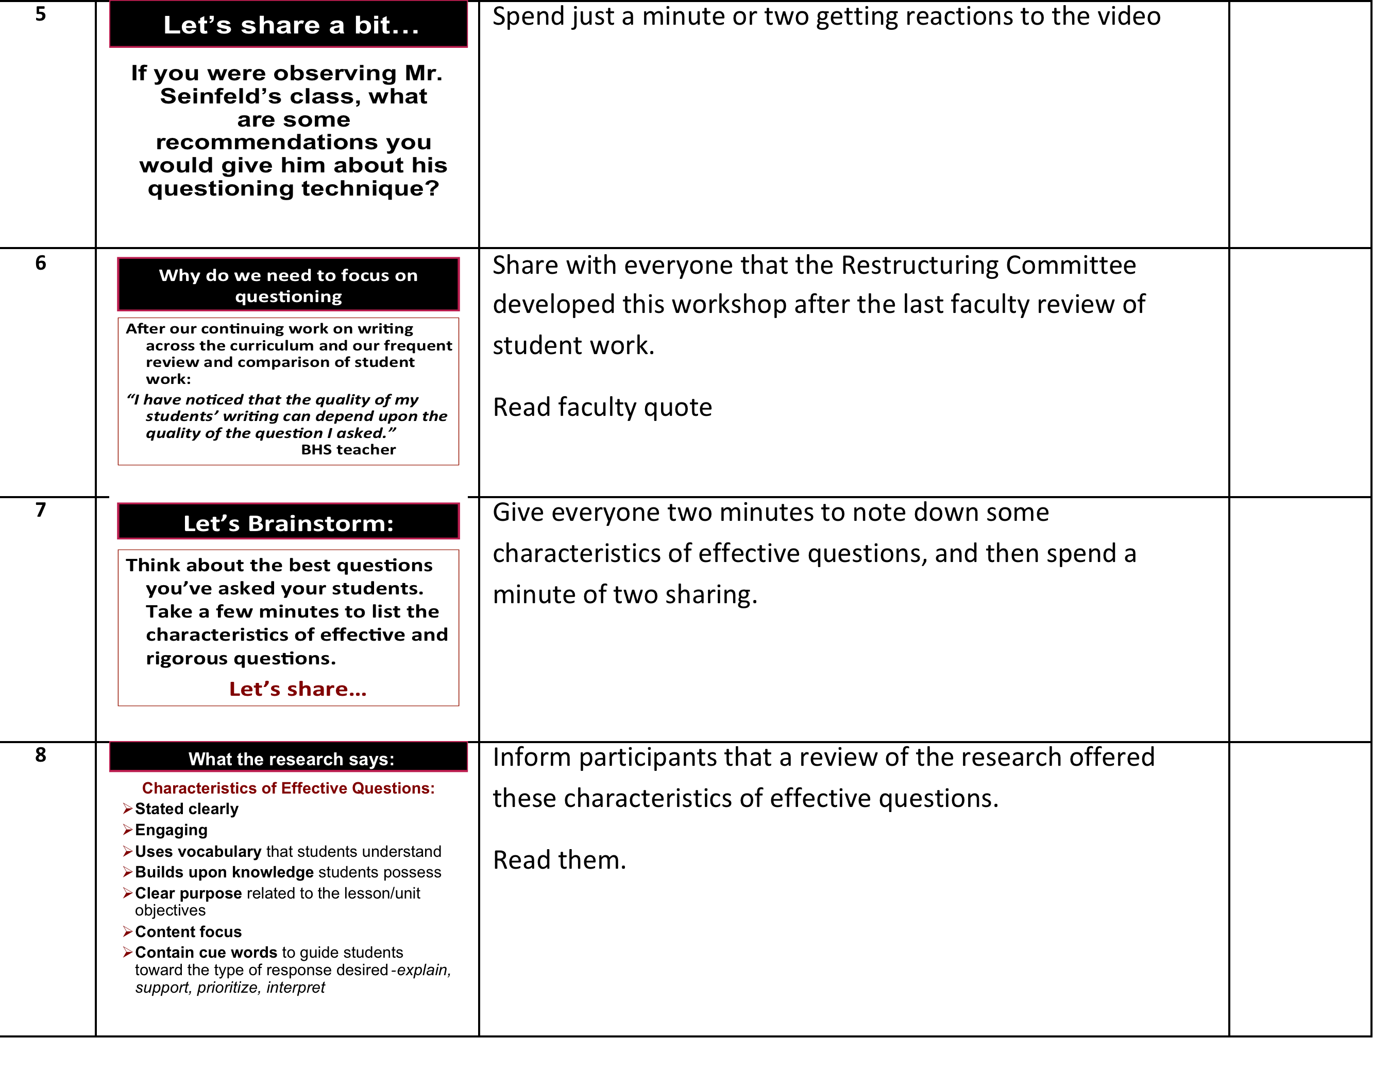

Slide 110
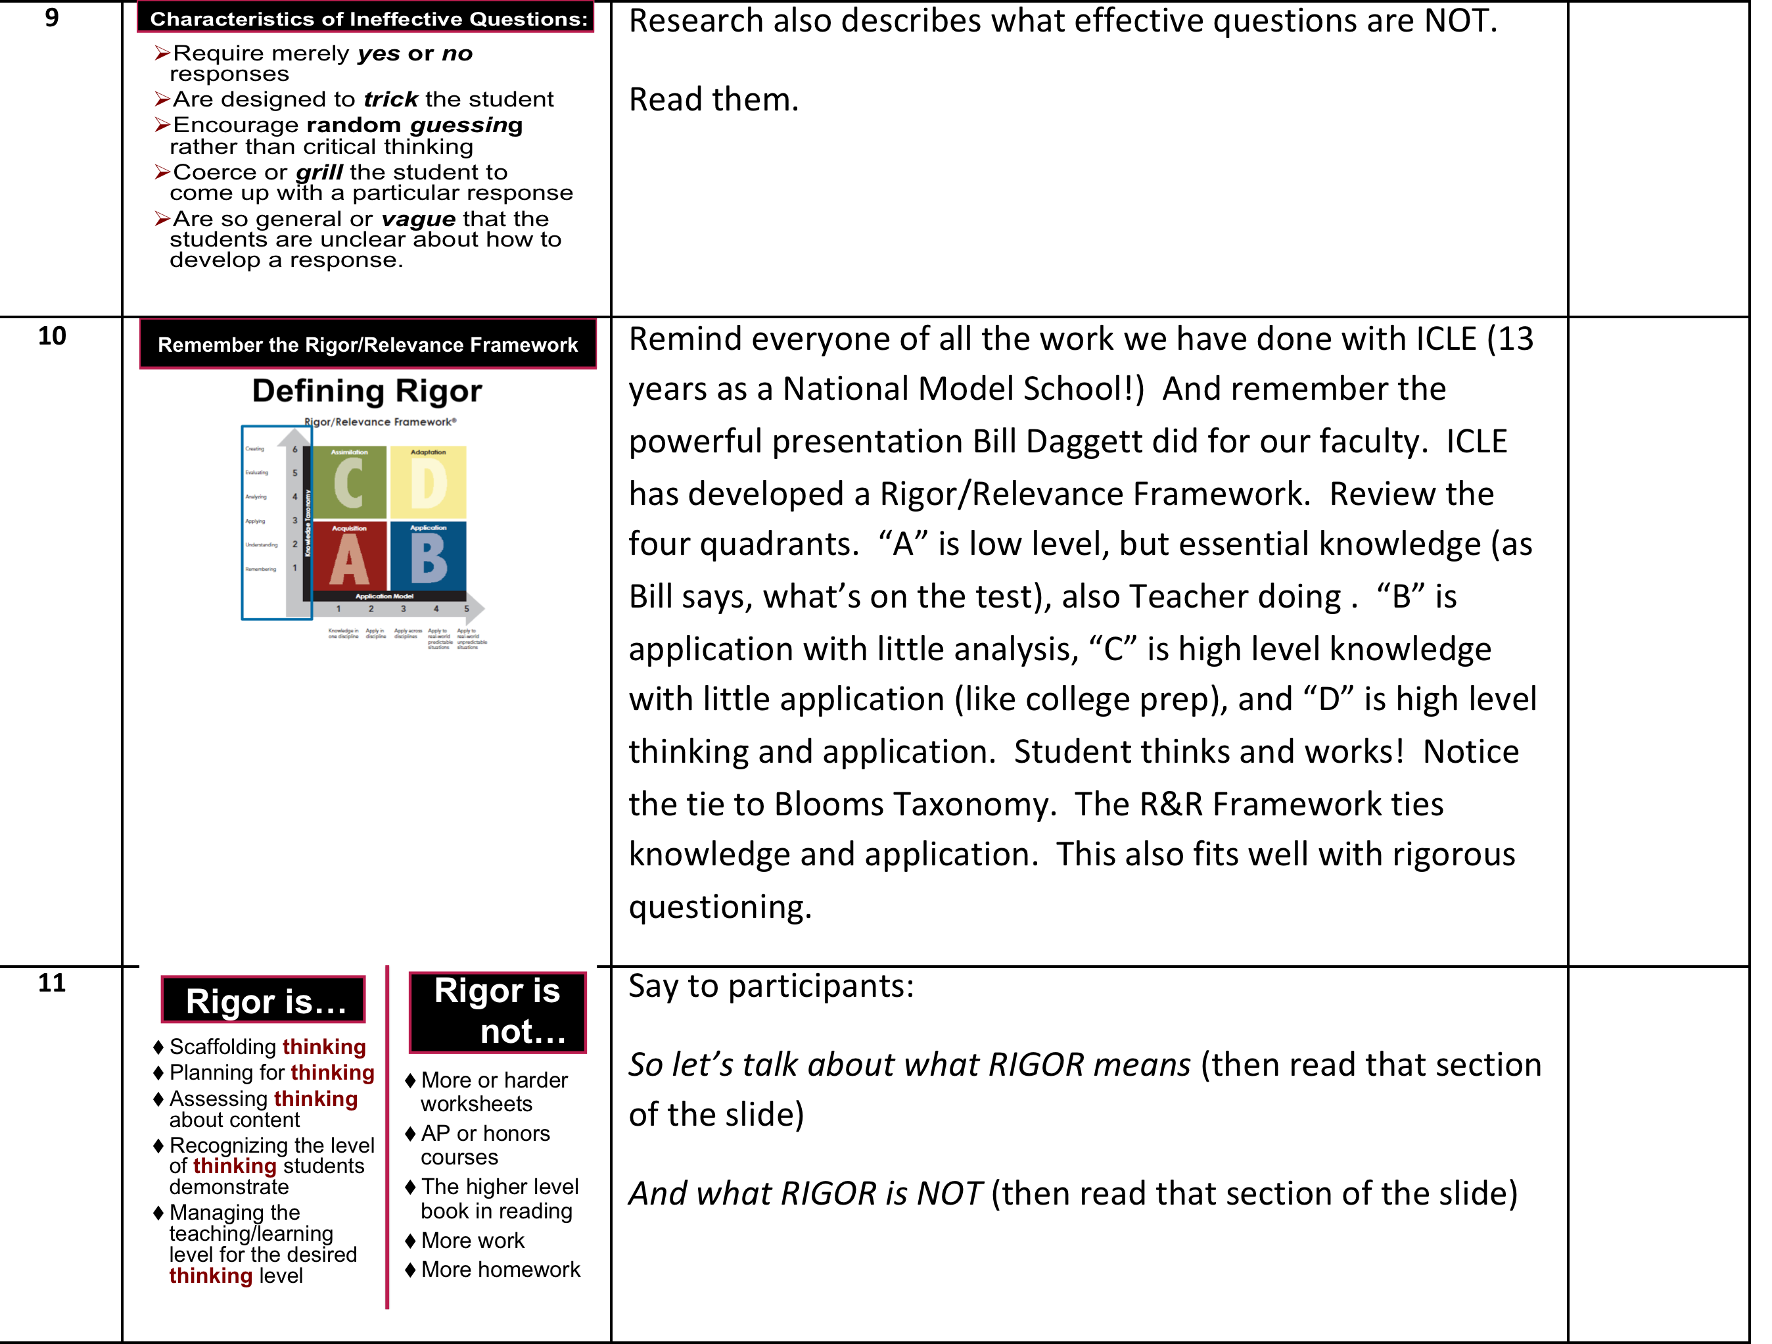

Slide 111
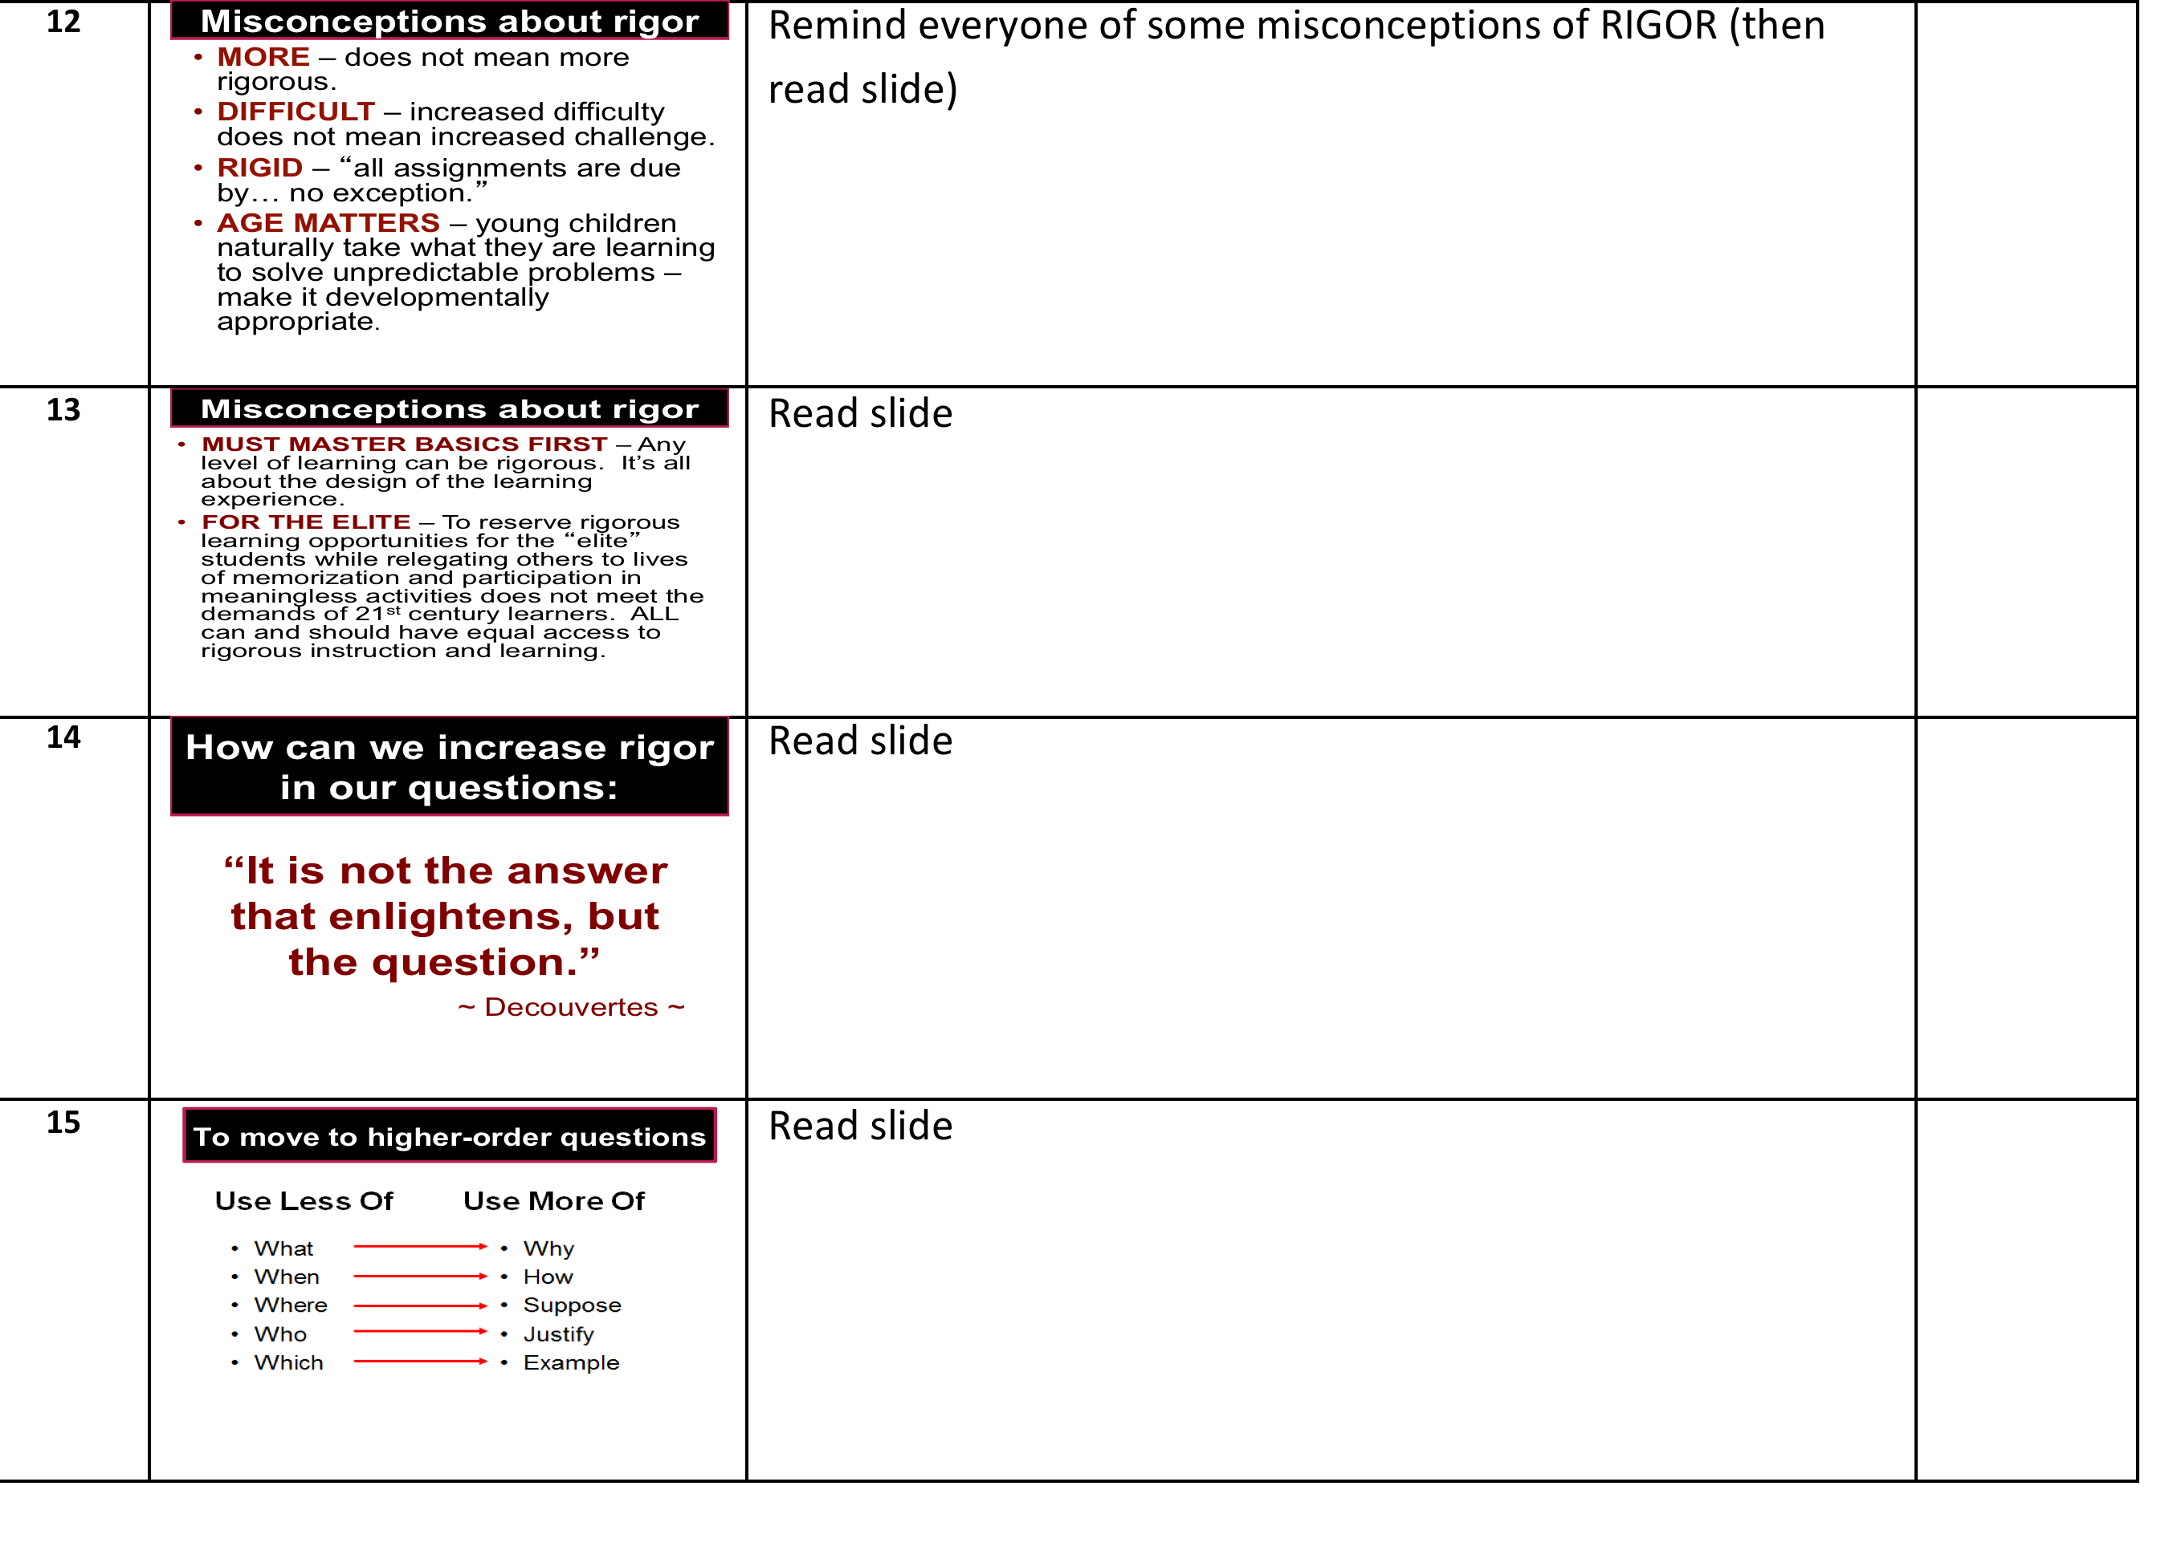

Slide 112
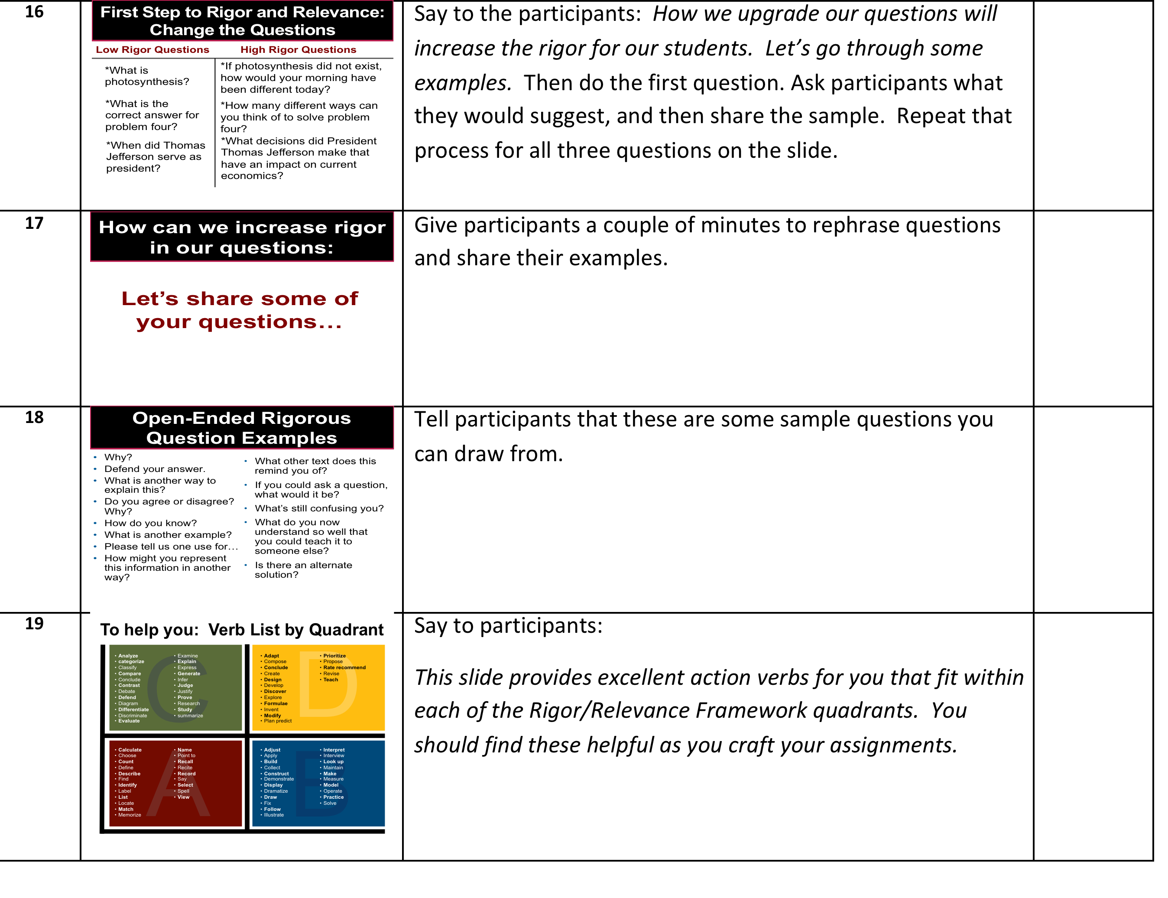

Slide 113
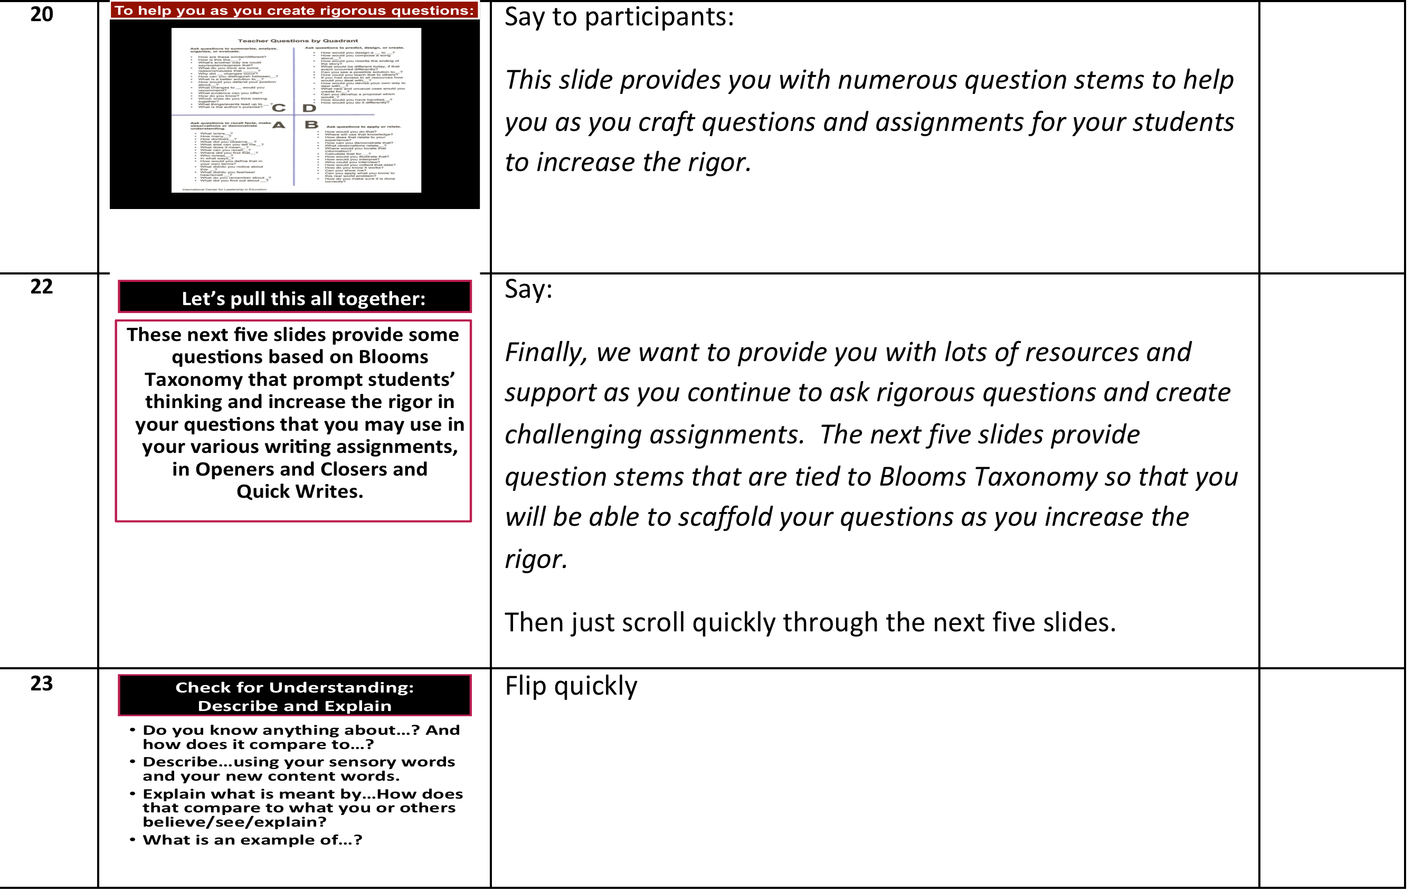
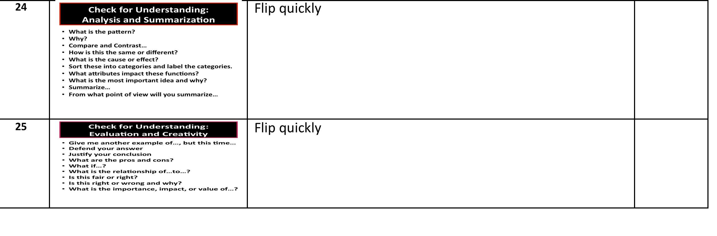

Slide 114
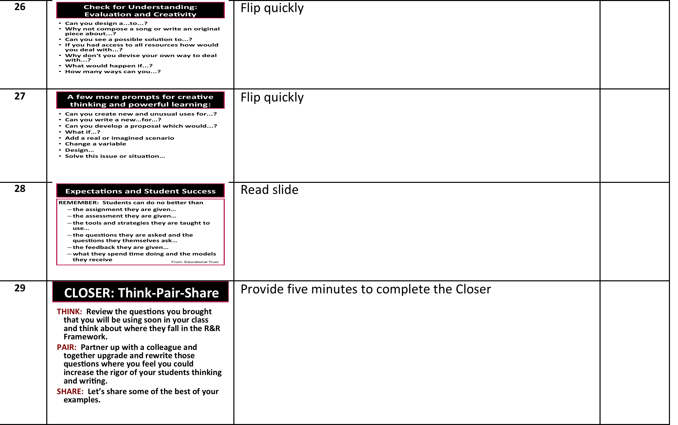


Slide 115

Structure we used for our Literacy Workshops
OPENER related to what we will be doing
WHAT we are presenting and WHY (data/ research if possible)
MODEL the steps the teachers will teach to the students
PRACTICE or DISCUSSION depending upon the focus of the workshop
NEXT STEPS
CLOSER bringing everything together

Slide 116

Teacher to Teacher!
Some of our Literacy Workshops focused on improving instruction by sharing “bang for your buck” techniques.
Here’s an example of one of our most highly rated using Teach Like a Champion:
Creating a Strong Classroom Culture:
Effective Entry Routines

Slide 117
Slide 1: 1 minute
Welcome everyone and introduce the workshop with the following:
*We have had great success helping our students – and the key has been because of effective instruction.
*We’ve been using Teach Like a Champion to add to our instructional repertoire.
*In today’s workshop we’ll talk about creating a strong classroom culture and again use Teach Like a Champion and focus on using powerful Entry Routines.

Slide 118
Slide 2: 1 minute
Read slide to review the workshop objectives and agenda

Slide 119
Slide 3: 8 min. total
Introduce the Activator by saying:
“We always try to model effective strategies in our Literacy Workshops. So, we will begin with an Activator. Please take 3 minutes to write a response to this question, and then we will spend five minutes discussing your responses.”

Slide 120
Slide 4: 3 minutes
Say: “These next two slides ask us to reflect on our good days and our not so good days. Take a look through your own classroom window. Take a minute to jot down some thoughts about what you see on your best day.”
Then ask participants to share. (2 min)

Slide 121
Slide 5: 3 minutes
Say, “Now, take a look through your own classroom window on a not so good day. Take a minute to jot down some thoughts about what you might see.”
Then ask participants to share. (2 min)

Slide 122
Slide 6: 10 minutes
Say: “We know that you are already using Entry Routines and Do Nows. Let’s take a look at what Teach Like a Champion suggests about these techniques.”
Then read the slide which explains what we would like participants to do.

Slide 123
Slide 7: 10 minutes
Say: “Let’s talk about what this looks like.”
Then discuss each of these three questions briefly with participants.

Slide 124
Slide 8: 1 minute
Say: “Think about your use of Entry Routines and how you can maximize this technique. This could be our Entry Routine and Agenda for this Workshop.”

Slide 125
Slides 8,9: 10 min total
Say: “Let’s see it in action. You all know Spanish teacher Noah Roseman. He agreed to let us film his effective entry routine with his students. As you watch the video, please, note what the teacher is doing, and what the students are doing, and then we’ll talk about it.”
Slide 9
Video of Mr. Roseman’s class – 4 minutes

Slide 126


Slide 127
Slides 10: 5 minutes
Say: “Every class needs a strong Closer, including our own Workshop. We asked you to bring a lesson plan with you. Take a look at it in light of what we did today and take a couple of minutes to analyze it. Then we’ll ask you to share your reflections with your “elbow partner.”
After approximately five minutes, bring the Workshop to a close and thank everyone for their participation and commitment to our students.

Slide 128
Final Words of Advice for Your Journey

Slide 129
Ten Important lessons to remember:
FOCUS: Determine what YOUR students need and be relentless – LITERACY!!!
INSTRUCTION – It’s about the adults!!! If you want to improve your school, focus on adult learning!
CONSISTENCY: We ALL do it “this” way – the power is in the school wide commitment (deliberate practice works!)
MONITOR: Compare and analyze student work across the school – raise the rigor!
RESISTANCE: You will always face naysayers and resisters. The key is how you deal with them.

Slide 130
CELEBRATE YOUR SUCCESS: Everybody feels better when they are valued. And remember, what we celebrate tells the students, faculty, and community what we value.
LEADERSHIP MATTERS: Not just positional leadership. Our transformation was teacher leadership.
REPLICATE: Don’t reinvent the wheel – replicate the process
NO EXCUSES – Figure out what you can control and what you can’t control, and go after what you CAN control.
HUMOR HUMOR HUMOR!!! Laugh every day – we are in a funny business… you just can’t make this stuff up!

Slide 131
THANK YOU THANK YOU THANK YOU!!!

Slide 132
OPTIONAL
We will remain available for an additional optional thirty minutes for anyone that would like to ask additional questions or discuss any issues further.
To everyone else I say THANK YOU for participating!!!

